Slide 1




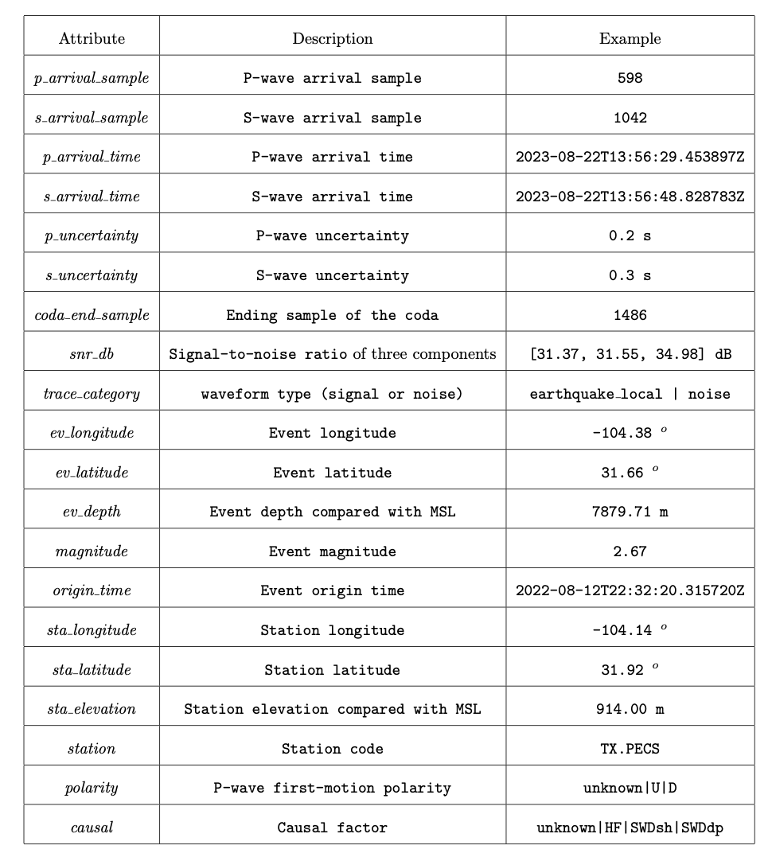
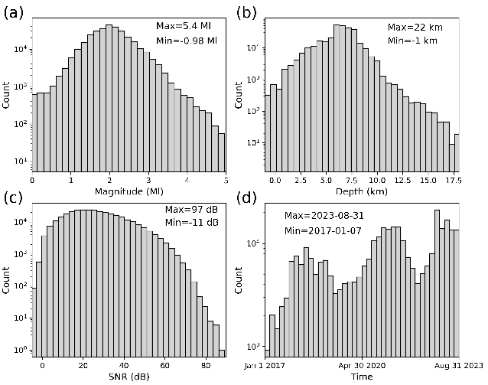
TXED: the Texas Earthquake Dataset for AI
Yangkang Chen¹, Alexandros Savvaidis¹, Omar M. Saad², Guo-Chin Dino Huang¹, Daniel Siervo¹, Vincent O’Sullivan¹,
Cooper McCabe¹, Bede Uku¹, Preston Fleck¹, Grace Burke¹, Natalie L. Alvarez¹, Jessica Domino¹, Iason Grigoratos³
¹The University of Texas at Austin; ²King Abdullah University of Science and Technology; ³ETH Zurich
Abstract
Method
Metadata
Results
Machine learning (ML) seismology relies on large datasets with high-fidelity labels from humans in order to train generalized models. Among the seismological applications of ML, earthquake detection, and P- and S-wave arrival picking are the most widely studied, with capabilities that can exceed humans. Here, we present a regional artificial intelligence (AI) earthquake dataset (TXED) compiled for the state of Texas. The TXED dataset is composed of earthquake signals with manually picked P- and S-wave arrival times and manually picked noise waveforms corresponding to more than 20,000 earthquake events spanning from the beginning of the Texas seismological network (TexNet) (2017/01/01) to date. This data is a supplement to the existing worldwide open-access seismological AI datasets and represent the signal and noise characteristics of Texas. Direct applications of the TXED datasets include training a globally generalized picking model by including the unique Texas dataset and refining an existing global picking model for better performance in Texas (i.e., transfer learning). This dataset will also serve as a benchmark dataset for fundamental AI research like designing seismology-oriented deep learning architectures. We plan to continue to expand the TXED dataset as more observations are made by TexNet analysts.
Application 1: Training a deep learning Phase pickier (EQCCT)
Figure 5. The error distribution for (a) P picks and (b) S picks using the EQCCT picking model on the test set.
Application 2: Training a single-station earthquake locator
Introduction
In the past decade, the seismology community has seen numerous successes in data-driven earthquake studies due to the rapid development of machine learning (ML) techniques. Among all ML techniques, deep learning (DL) research has dominated in almost all natural science domains. DL commonly relies on convolutional operations or recurrent neural networks (RNN) to uncover deeply hidden patterns from a huge number of training datasets and thus hopefully can outperform traditional shallow-learning algorithms.
The state of Texas is one of the most seismically active areas in North America due
to the large-scale wastewater injection as a result of oil and gas production. The number of small earthquakes (M>2.0) has continued to increase rapidly in the past five years. To facilitate the earthquake AI study in Texas, we compile a large-scale dataset of Texas, which includes 312,231 signal 3-C waveforms and 207,458 noise 3-C waveforms recorded by over 300 stations across Texas. The noise waveforms from Texas all have gone through a robust manual picking process and have a relatively high quality, which is beneficial in reducing the false alarms in phase arrival picking and various noise studies.
Figure 6. The error distribution for (a) depth and (b) station-event distance using the ConvMixer deep learning architecture on the test set.
Application 3: transfer learning
Table 1. A detailed description of the attributes in TXED. MSL denotes mean surface level. HF denotes hydraulic fracturing. SWDsh denotes shallow saltwater disposal. SWDdp denotes deep saltwater disposal.
Sample Signal and Noise Waveforms
Figure 7. The error distribution for the P picks corresponding to (a) the pre-trained EQCCT model and (b) the fine-tuned EQCCT model. The error distribution for the S picks corresponding to (c) the pre-trained EQCCT model and (d) the fine-tuned EQCCT model.
Conclusions
We have presented a large-scale regional earthquake dataset compiled from the state of Texas (TXED) for seismic artificial intelligence (AI) studies, which has a wide spectrum of possible AI applications in the future, including earthquake detection, P- and S-wave phase picking, polarity determination, single-/multi-station location, magnitude estimation, and causal factor determination, etc. The high-quality manually picked 3-C noise waveforms facilitate a number of noise studies, including noise removal, ambient noise analysis and imaging, noise causal factor analysis, and optimal survey design. The TXED will be continuously maintained and developed to expand the data size and functionality. Several initial applications of the TXED in phase picking, single-station location, and transfer learning studies demonstrate its promising scientific merits.
Figure 4. Several noise waveform examples in different cases. (a) & (b) Random noise with low and high amplitudes, respectively. (c) Pump noise near operating wells. (d) Noise from a malfunctioning station. (e) & (f) Regular noise with unknown causes.
Figure 3. Several signal waveform examples. (a) & (b) Signal waveforms of small earthquakes. (c) Signal waveforms of moderate-size earthquake. (d) Signal waveforms of the large earthquake (the M5.4 Coalson earthquake). The red and blue vertical lines denote P- and S-wave arrivals, respectively. The waveform ID is indicated in the title of each figure. The plotting script of an arbitrary signal waveform is provided in the online GitHub repository (https://github.com/chenyk1990/txed).
Reference
Figure 2. Distribution of signal waveforms. (a) Magnitude distribution. (b) Depth distribution. (c) SNR distribution. (d) Event origin time distribution. The maximal and minimal values of each scenario are indicated in each panel.
Chen, Y., A. Savvaidis, O. M. Saad, G.-C. D. Huang, D. Siervo, V. O’Sullivan, C. McCabe, B. Uku, P. Fleck, G. Burke, N. L. Alvarez, J. Domino, and I. Grigoratos, 2023, TXED: the Texas earthquake dataset for AI: Seismological Research Letters, under review.
Saad, O. M., Y. Chen, D. Siervo, F. Zhang, A. Savvaidis, G. chin Dino Huang, N. Igonin, S. Fomel, , and Y. Chen, 2023, EQCCT: A production-ready earthquake detection and phase picking method using the compact convolutional transformer: IEEE Transactions on Geoscience and Remote Sensing, 61, 4507015.
Elsayed, H. S., O. M. Saad, M. S. Soliman, Y. Chen, and H. A. Youness, 2023, EQConvMixer: A deep learning approach for earthquake location from single-station waveforms: IEEE Geoscience and Remote Sensing Letters, 10, 7504905.
Figure 1. TexNet station and event distribution on the map. There are 21,767 earthquake events and 321 stations included in the current version of TXED.

